Slide 1
MongoDB
3IF Lab Support
Előd EGYED-ZSIGMOND

Slide 2
Plan
Introduction
Data modeling
Practice
CRUD queries
Aggregates
Indexes
Replication
Sharding/ Partitioning
Conclusion

Slide 3
Introduction
MongoDB, one of the most popular "NoSQL" DBMS
It is a "document based" NoSQL system (with CouchDB, ElasticSearch, ...)
relies on a semi-structured data model of (JSON encoding);
Schema less (flexibility);
An original (and specific) query language original;
No (or very little) of transactional support.
Built from the beginning as a scalable and distributed system
Distribution by partitioning (sharding) ;
Fault tolerance through replication.

Slide 4
Why MongoDB
A MongoDB server manages data bases.
A database contains collections.
The collections have documents.
Each document has a unique identifier generated by MongoDB, _id field.

Slide 5
Document oriented
The documents (lines) of the same kind are stored in collections (tables)
A document is a tree, made of keys and values
A value can be:
  Scalar (int, long, string, date, binary, bool, etc.)
  Array
  A nested document

Slide 6
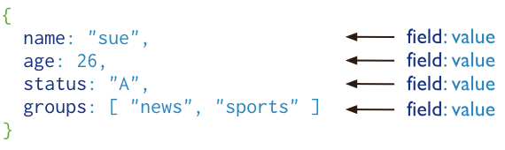
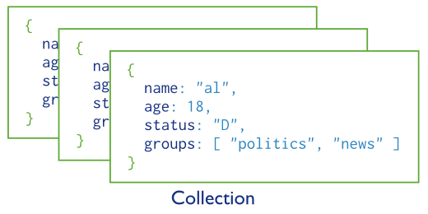
Vocabulary
Document
Collection
http://docs.mongodb.org/manual/core/crud-introduction/

Slide 7
Plan
Introduction
Data modeling
Practice
CRUD queries
Aggregates
Indexes
Replication
Sharding/ Partitioning
Conclusion

Slide 8
How to model
complex document
  nested documents
  the value objects are part of the document
  Sometimes greedy (denormalisation)
  (current) limit: 4MB per document
normalization
mixed approach

Slide 9
JSON: Modeling
Mat Keep: https://www.slideshare.net/matkeep/migrating-from-relational-databases-to-mongodb
Notes:
Pas de jointure => modèle imbriqué
Linking pour éviter la redondance des données

Slide 10
JSON: Modeling
RDBMS: Join 5 tables
Mat Keep: https://www.slideshare.net/matkeep/migrating-from-relational-databases-to-mongodb
Notes:
Pas de jointure => modèle imbriqué
Linking pour éviter la redondance des données

Slide 11
JSON: Modeling
MongoDB: Denormalized to 2 BSON documents
Mat Keep: https://www.slideshare.net/matkeep/migrating-from-relational-databases-to-mongodb
Notes:
Pas de jointure => modèle imbriqué
Linking pour éviter la redondance des données

Slide 12
Document Model Benefits
• Rich data model, natural data representation
  – Embed related data in sub-documents & arrays
  – Support indexes and rich queries against any element
• Data aggregated to a single structure (pre-JOINed)
  – Programming becomes simple
  – Performance can be delivered at scale
• Dynamic schema
  – Data models can evolve easily
  – Adapt to changes quickly: agile methodology

Slide 13
Plan
Introduction
Data modeling
Practice
CRUD queries
Aggregates
Indexes
Replication
Sharding/ Partitioning
Conclusion

Slide 14
Convenient
MongoDB comes with a shell: bin/mongo
Start server with: bin/mongod
Some arguments:
--dbpath <path>: Data Storage path
--port <port>: Port the server listens
--replSet <Name>: Enter the server in a replicas cluster

Slide 15
Shell
View the current database:
  db
See list of existing databases:
  show dbs
Select / create a database:
  use <name>
View Collections:
  show collections
Create collection (required)
  db.createCollection

Slide 16
Plan
Introduction
Data modeling
Practice
CRUD queries
Aggregates
Indexes
Replication
Sharding/ Partitioning
Conclusion

Slide 17
Queries in MongoDB
JSON queries
We find the equivalent of SQL projections
Some default aggregations
  ... Map/Reduce for the others

Slide 18
SQL to Aggregation Mapping
SQL Terms, Functions, and Concepts | MongoDB Aggregation Operators
WHERE | $match
GROUP BY | $group
HAVING | $match
SELECT | $project
ORDER BY | $sort
LIMIT | $limit
SUM() | $sum
COUNT() | $sum $sortByCount
join | $lookup
Mapping Chart:
http://docs.mongodb.org/manual/reference/sql-aggregation-comparison/

Slide 19
CRUD
Modification:
Insert
Update
Remove
The operations are applied to a collection
http://docs.mongodb.org/manual/

Slide 20
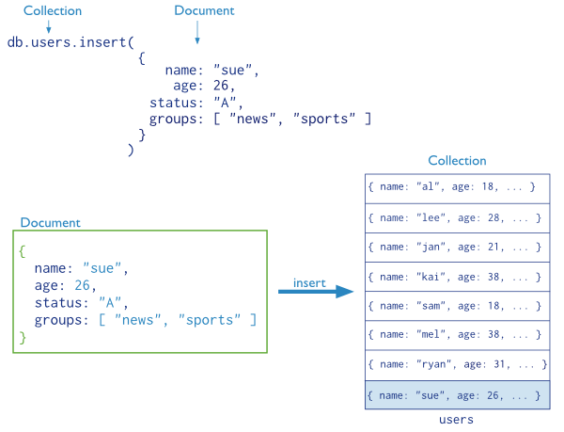
CRUD
Insertion
The "_id" field is automatically added / alternative to save
http://docs.mongodb.org/manual/
Notes:
Regarder fic texte

Slide 21
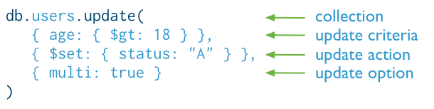
CRUD
Update
db.collection.update(
<Query>
<Update>
{
upsert<boolean>
Multi <boolean>
writeConcern: <Document>
}
)
Default update concerns a single document
Same constraints as find
$ Set, $a set...
http://docs.mongodb.org/manual/

Slide 22
CRUD
Update
db.movies.update({ "year"{$lt: 2000}}, {$ set: {old: true}})
db.movies.find({old: true})
db.movies.updateMany({ "year"{$lt: 2000}}, {$ set: {old: true}})
db.movies.update({ "year"{$lt: 2000}}, {$a set : {old: true}})
db.movies.update({ "year"{$lt: 2000}}, {$ set: {old: true}}, {Multi: true})
(since
MongoDB 3.2)
Notes:
Regarder exemples!
db.films.update({"year": {$lt: 2000}},{$set : {old:true}})
db.films.find({old:true})
db.films.update({"year": {$lt: 2000}},{$unset : {old:true}})
db.films.update({"year": {$lt: 2000}},{$set : {old:true}}, {multi:true})

Slide 23
CRUD
Update, update a table
We will add a table to a document
db.produits.insert({Counter: 100001, tab: [ 'a', 'b', 'c']})
You can view it with the following command:
db.produits.find({Counter: 100001})
Now to add an item to the table, use the operand $ push:
db.produits.update({Counter: 100001} {$ push: {tab: 'd'}})
To add several items at once, there is $pushAll to add a whole table.
Notes:
db.films.update({"year": {$lt: 2000}},{$set : {old:true}})
db.films.find({old:true})
db.films.update({"year": {$lt: 2000}},{$unset : {old:true}})
db.films.update({"year": {$lt: 2000}},{$set : {old:true}}, {multi:true})

Slide 24
CRUD
Update a table
The $pop operand will remove the last item:
db.produits.update({Counter: 100001} {$ pop: {tab: 1}})
The array has lost its last element "d".
To remove the first element:
db.produits.update({Counter: 100001} {$ pop: {tab: -1}})
Analogously with the sort method, with -1 elements are deleted in the other direction.
With the operand $addToSet an item is added without duplication:
db.produits.update({Counter: 100001} {$addToSet : {Tab: 'b'}})
The "b" value was present in the table so it is not added.

Slide 25
CRUD
Changes, isolation
db.films.update(
{ old: true, $isolated : 1},
{$Inc. : {Count: 1}},
{Multi: true }
)
db.products.remove(
{ qty: {$ Gt: 20}, $isolated: 1})
$isolated does not work on distributed collections

Slide 26
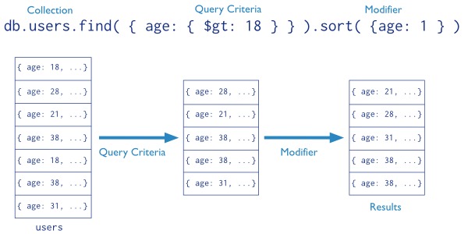
CRUD
queries
http://docs.mongodb.org/manual/

Slide 27
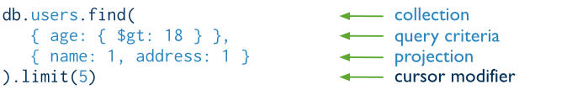
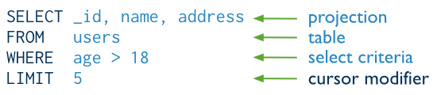
CRUD
queries
in SQL
db.movies.find({ "Country": {$do: "USA"}}, {_ Id: 0, title: 1
}).limit(5)
http://docs.mongodb.org/manual/

Slide 28
operators
$eq | = | values ​​which are equal to a specified value.
$gt | > | values ​​that are greater than a specified value.
$gte | > = | values ​​that are greater than or equal to a specified value.
$lt | < | values ​​which are less than a specified value.
$lte | <= | values ​​that are less than or equal to a specified value.
$ne | != | all values ​​that are not equal to a specified value.
$in | ∈ | one of the values ​​specified in a table.
$nin | ∉ | none of the values ​​specified in the table.
$gold
$and
$not
$nor
...
http://docs.mongodb.org/manual/reference/operator/query/

Slide 29
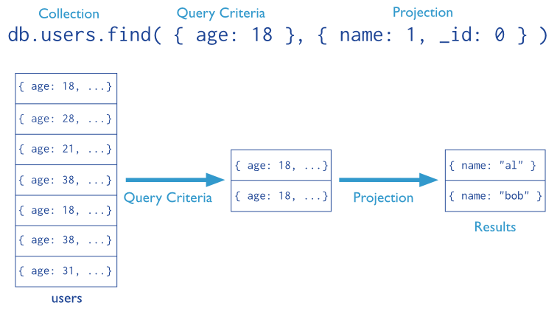
CRUD
projection
db.movies.find({ "Country"{$do: "USA"}}, {_ Id: 0, title: 1})

Slide 30
CRUD Examples
Exclude the year:
db.films.find({ "country":"USA"}, {Year: 0})
Return the title and genre and _id
db.films.find({ "country":"USA"}, {title1, type: 1})
Return movies with a given role
db.films.find({ "actors.role":"William Munny"})
Return the title and genre
db.films.find({ "country ":" USA"}, {title: 1, type: 1, _id: 0})
Sort Results
db.films.find({ "year":{$ Gt: 2000}}).sort({year: -1})

Slide 31
CRUD
Examples
db.movies.find({$and : [{"year": 2003}, {genre: "romance"}] },{"title":1,"genre":1});
db.movies.find({$or : [{"year": 2003}, {genre: "romance"}] },{"title":1,"genre":1});

Slide 32


CRUD
sliders
db.collection.find()
db.films.find({ "Country": "FR"})
Course one by one results
Notes:
var myCursor = db.films.find( { country: 'FR' } );
while (myCursor.hasNext()) {
print(tojson(myCursor.next()));
}
var myCursor = db.films.find( { country: 'FR' } );
myCursor.forEach(printjson);

Slide 33
CRUD
Cursors, methods
limit(n): To retrieve only first n results
sort (…): To sort the results
skip (n): To skip n results
For example, for the penultimate film in the name, you could do:
var cur = db.films.find();
cur.sort({title: -1}).limit(1).skip (2);
Notes:
var cur = db.films.find()
cur.sort( {title: -1} ).limit(1).skip(2)

Slide 34

CRUD
Cursors
Transformation into an array
Analyze query performance
db.films.find({Country: 'FR'}).explain();
db.films.createIndex({country: 1})
Notes:
var myCursor = db.films.find( { country: 'FR' } );
var documentArray = myCursor.toArray();
var myDocument = documentArray[1];
print(tojson(myDocument));
db.films.find( { country: 'FR' } ).explain();
db.films.createIndex( { country: 1 } )
Puis
db.films.find( { country: 'FR' } ).explain();

Slide 35
Plan
Introduction
Data modeling
Practice
CRUD queries
Aggregates
Indexes
Replication
Sharding/ Partitioning
Conclusion

Slide 36
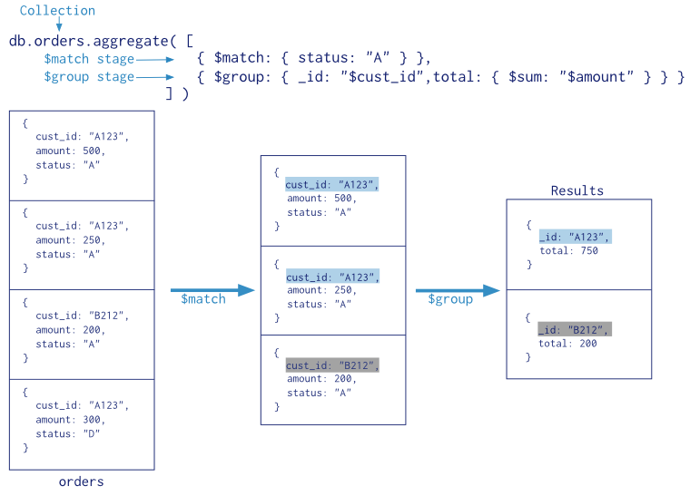
aggregates
https://docs.mongodb.org

Slide 37
aggregates
Nb films by genre
db.movies.aggregate([
{$group:{_id:"$genre",count:{$sum:1}}}
])
Number of American films by genre
db.movies.aggregate([
{$match:{country:"USA"}},
{$group:{_id:"$genre",count:{$sum:1}}}
])
Date of first horror movie
db.movies.aggregate([
{$match:{genre:"Horreur"}},
{$group:{_id:"$genre",debut:{$min:"$year"}}}
])

Slide 38
Plan
Introduction
Data modeling
Practice
CRUD queries
Aggregates
Indexes
Replication
Sharding/ Partitioning
Conclusion

Slide 39
indexes
Very similar to the RDBMS, indexation in MongoDB is made on one or more fields.
Improves search performance.
The indexes are stored in the collections.
Provides overload for write operations.
The internal operation is very similar to that found in the current DBMS.

Slide 40
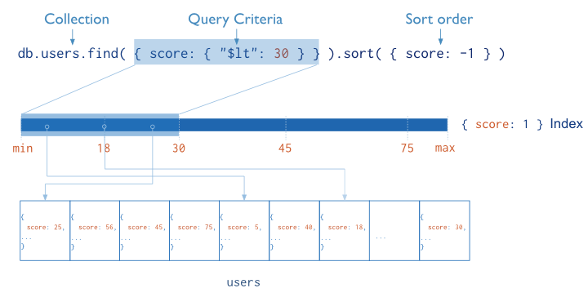
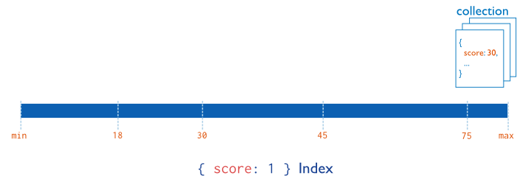
indexes
https://docs.mongodb.org

Slide 41
indexes
Types of indexes
single field
composed field
multi key
geo spatial
text
Hashed

Slide 42
indexes
Consider using indexes effectively.
A query, a bit field has no interest in being indexed
Although we speak of NoSQL the indexes are similar to those in the RDBMS.

Slide 43
Loading Documents
unitary insert:
  Example: coll.insert({x:1,y:2,z:"test"})
  Command to avoid for large inserts via a client (> 10 000 documents)
Bulk insert:
    Example: var Documents = [];
    for(var i = 1; i < 10 000; i++) { documents.push({x:i,y:i, z:"test"})};
    db.coll.insert(documents);

Slide 44
Inserting massive documents
Program to load a BSON file containing hundreds of GB or more in a MongoDB base: mongorestore
Mongorestore: Method far more effective to insert data (other methods: ( bulk ) Insert, mongoimport )
Backup / Restore tool of a MongoDB base ( Sharded ) with mongodump
Notes:
Description du mécanisme de sauvegarde/restauration d’une base en annexe

Slide 45
other features
geographic queries
Javascript running on the server
  db.eval (~ Stored procedures)
  map/Reduce (Aggregations)
  db.system.js (functions)

Slide 46
Plan
Introduction
Data modeling
Practice
CRUD queries
Aggregates
Indexes
Replication
Sharding/ Partitioning
Conclusion

Slide 47
Replication
What brings replication?
- Redundancy
- Simplify tasks (backups, ...)
- Increase reading ability
A replica set is a cluster of MongoDB instances.
master / slave strategy
There must ALWAYS be a single master.

Slide 48
Replication
The master to the slave replication is asynchronous.
Synchronous: Blocking / Expensive / Strong consistency
Asynchronous: No blocking / Data refreshing mandatory.

Slide 49
Plan
Introduction
Data modeling
Practice
CRUD queries
Aggregates
Indexes
Replication
Sharding/ Partitioning
Conclusion

Slide 50
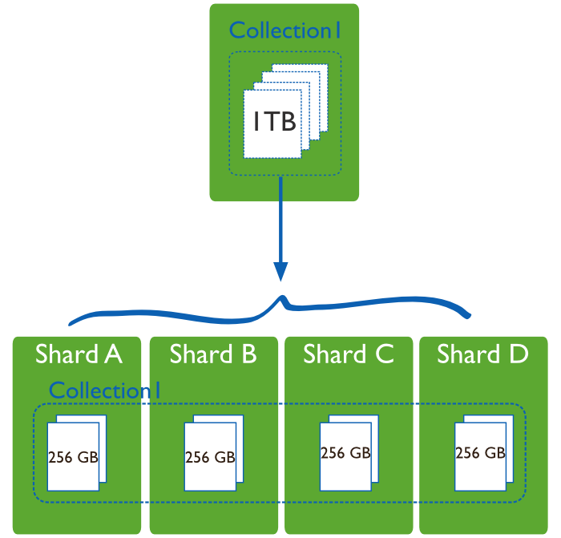
sharding
The sharding enables automatic data partitioning
https://docs.mongodb.org

Slide 51
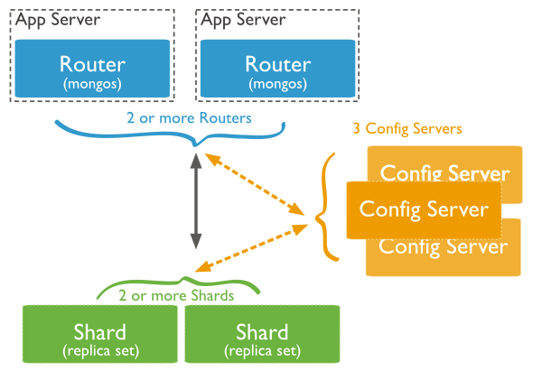
sharding
https://docs.mongodb.org

Slide 52
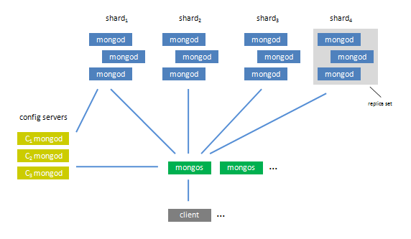
sharding and replication

Slide 53
Plan
Introduction
Data modeling
Practice
CRUD queries
Aggregates
Indexes
Replication
Sharding/ Partitioning
Conclusion

Slide 54
More Information
Resource Location
MongoDB Downloads mongodb.com/download
Free Online Training education.mongodb.com
Webinars and Events mongodb.com/events
White Papers mongodb.com/white-papers
Case Studies mongodb.com/customers
Presentations mongodb.com/presentations
Documentation docs.mongodb.org

Slide 55
References
http://nosql.developpez.com/
http: //news.humancoders.com/t/nosql/
https://docs.mongodb.com/manual/reference/sql-comparison/
MongoDB
Official site : www.mongodb.org
A client: https://studio3t.com/

